Slide 1
AMD Raphael(7000 series)
光電所
110066534
陳俊翰

Slide 2
Outline
General uses
Product timeline
System description
Technology analysis
Industry analysis
Applications
Future
reference

Slide 3
General uses

Slide 4
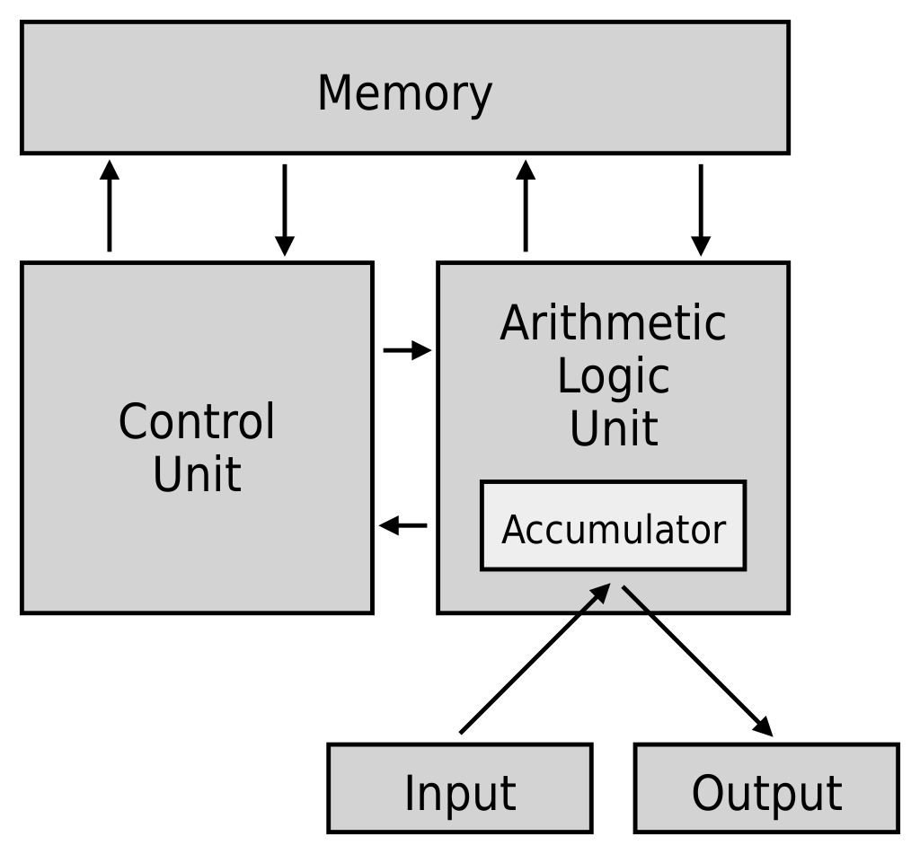
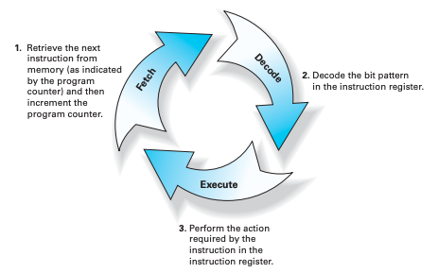
CPU function
General uses
Notes:
Help human compute sophisticated matters
It simply use three instructions, fetch, decode, and execute to complete work
First the CPU will fetch, take the data we want from the memory, and copied into instruction register (IR).
Now, the instruction needs to be decoded, it is sent via the data bus to the control unit and split into two parts, operation code and operand.
After the control unit translating opcodes into instructions, finally, the command will be executed.

Slide 5
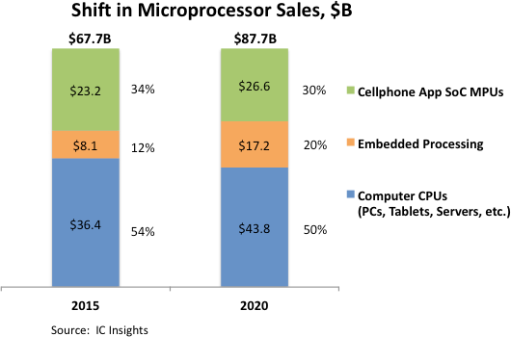
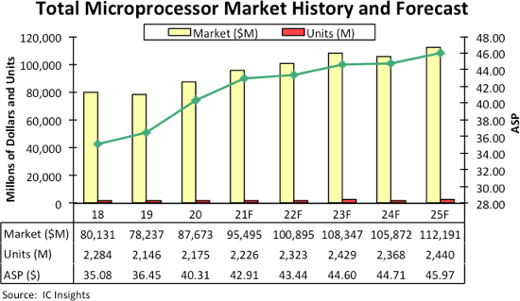
Market
General uses
Notes:
A market size can determine how far the product go
As you can see, at 2015 and 2020, for all 67.7B microprocessors sales, computer CPUs have a significant rate, which is over 50%
And for the future, microprocessors sales may have a rise to 120B dollars at 2025

Slide 6
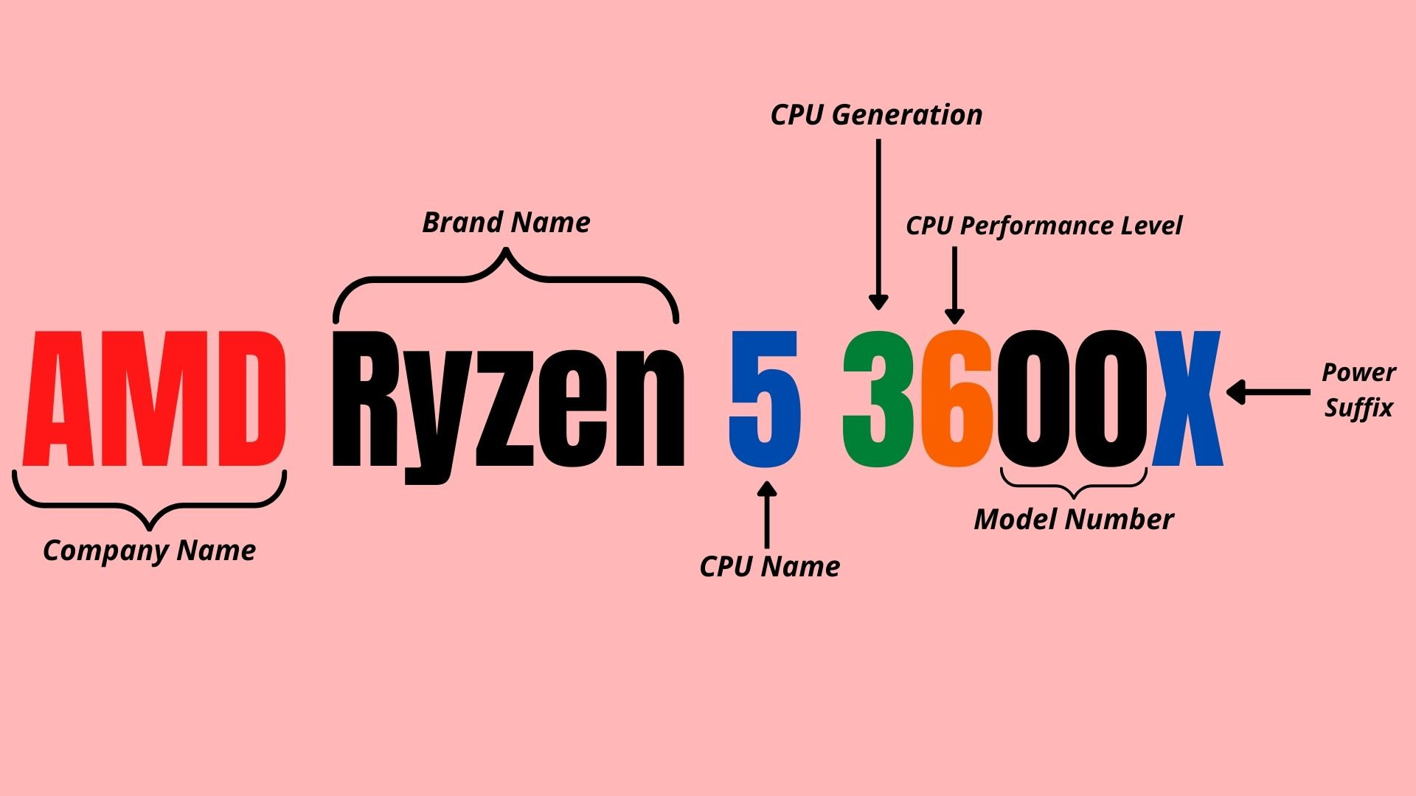
General uses
Ryzen Raphael (7000 series CPUs)
Ryzen 5 7600X
Ryzen 7 7700X
Ryzen 9 7900X
Ryzen 9 7950X
Ryzen 3 — Up to 4-core processors.
Ryzen 5 — Up to 6-core processors.
Ryzen 7 — Up to 8-core processors.
Ryzen 9 — Up to 16-core processors.
Ryzen Threadripper — Up to 64-core processors.
Ryzen 3 1xxx —1000 series CPUs
Ryzen 3 1xxxX —having high clock speed, power, consumption, and speed
Notes:
So how do we know the CPU we buy is suitable for us
Take AMD for example
As for today’s topic, 7000 series
You can see that ryzen 5, 7, 9 means how many cores it have
And we know they are all 7 generation because of the first number after the CPU name and their performance level
Typically, AMD famous for its overclocking, and they will add an X at the back to this type of CPU
X means its Extended Frequency Range which allows boosting up the performance process exceeding the limit.

Slide 7
Product timeline

Slide 8
AMD product timeline(to 4th generation)
Product timeline
Zen based(1st generation)
Summit Ridge (1000 series CPUs)
Fabrication process: GlobalFoundries 14 nm
Entry-level
Ryzen 3 1200
Ryzen 3 PRO 1200
Ryzen 3 PRO 1300
Ryzen 3 1300X
Mainstream
Ryzen 5 1400
Ryzen 5 PRO 1500
Ryzen 5 1500X
Ryzen 5 1600
Ryzen 5 PRO 1600
Ryzen 5 1600X
Performance
Ryzen 7 1700
Ryzen 7 PRO 1700
Ryzen 7 1700X
Ryzen 7 1800X
High-end desktop(HEDT)
Ryzen Threadripper 1900X
Ryzen Threadripper 1920X
Ryzen Threadripper 1950X
Raven Ridge (2000 series APUs)
Fabrication process: GlobalFoundries 14 nm
Includes integrated GCN 5th generation GPU
Ryzen 3 2200GE
Ryzen 3 PRO 2200GE
Ryzen 3 2200G
Ryzen 3 PRO 2200G
Ryzen 5 2400GE
Ryzen 5 PRO 2400GE
Ryzen 5 2400G
Ryzen 5 PRO 2400G
Zen+ based(2nd generation)
Pinnacle Ridge (2000 series CPUs)
Fabrication process: GlobalFoundries 12 nm
Entry-level
Ryzen 3 1200(AF)
Ryzen 3 2300X
Mainstream
Ryzen 5 2500X
Ryzen 5 2600E
Ryzen 5 1600(AF)
Ryzen 5 2600
Ryzen 5 2600X
Performance
Ryzen 7 2700E
Ryzen 7 2700
Ryzen 7 PRO 2700
Ryzen 7 PRO 2700X
Ryzen 7 2700X
High-end desktop(HEDT)
Ryzen Threadripper 2920X
Ryzen Threadripper 2950X
Ryzen Threadripper 2970WX
Ryzen Threadripper 2990WX
Picasso (3000 series APUs)
Fabrication process: GlobalFoundries 12 nm
Includes integrated GCN 5th generation GPU
Ryzen 3 Pro 3200GE
Ryzen 3 3200G
Ryzen 3 Pro 3200G
Ryzen 5 Pro 3350GE
Ryzen 5 Pro 3350G
Ryzen 5 Pro 3400GE
Ryzen 5 3400G
Ryzen 5 Pro 3400G
Zen 2 based(3rd generation)
Matisse and Castle Peak (3000 series CPUs)
Fabrication process: TSMC 7 nm FinFET
Matisse (desktop), Castle Peak (Threadripper)
Entry-level
Ryzen 3 3100
Ryzen 3 3300X
Mainstream
Ryzen 5 3500
Ryzen 5 3500X
Ryzen 5 3600
Ryzen 5 Pro 3600
Ryzen 5 3600X
Ryzen 5 3600XT
Performance
Ryzen 7 Pro 3700
Ryzen 7 3700X
Ryzen 7 3800X
Ryzen 7 3800XT
Enthusiast
Ryzen 9 3900
Ryzen 9 Pro 3900
Ryzen 9 3900X
Ryzen 9 3900XT
Ryzen 9 3950X
High-End Desktop (HEDT)
Ryzen Threadripper 3960X
Ryzen Threadripper 3970X
Ryzen Threadripper 3990X
Workstation
Ryzen Threadripper Pro 3945WX
Ryzen Threadripper Pro 3955WX
Ryzen Threadripper Pro 3975WX
Ryzen Threadripper Pro 3995WX
Renoir (4000 series CPUs)
Fabrication process: TSMC 7 nm FinFET
Based on the Ryzen 4000G series APUs with the integrated GPU disabled
Ryzen 3
Ryzen 3 4100
Ryzen 5
Ryzen 5 4500
Renoir (4000 series APUs)
Fabrication process: TSMC 7 nm FinFET
Includes integrated GCN 5th generation GPU
Ryzen 3 4300GE
Ryzen 3 4300G
Ryzen 5 4600GE
Ryzen 5 4600G
Ryzen 7 4700GE
Ryzen 7 4700G
Zen 3 based(4th generation)
Vermeer and Chagall (5000 series CPUs)
Fabrication process: TSMC 7 nm FinFET
Vermeer (desktop), Chagall (Threadripper)
The Ryzen 5 5500 is a Cezanne APU with its integrated GPU disabled
Mainstream
Ryzen 5 5500
Ryzen 5 5600
Ryzen 5 5600X
Performance
Ryzen 7 5700X
Ryzen 7 5800
Ryzen 7 5800X
Ryzen 7 5800X3D
Enthusiast
Ryzen 9 5900
Ryzen 9 5900X
Ryzen 9 5950X
High-end desktop/Workstation
Ryzen Threadripper PRO 5945WX
Ryzen Threadripper PRO 5955WX
Ryzen Threadripper PRO 5965WX
Ryzen Threadripper PRO 5975WX
Ryzen Threadripper PRO 5995WX
Cezanne (5000 series APUs)
Fabrication process: TSMC 7 nm FinFET
Includes integrated GCN 5th generation GPU
Ryzen 3 5300GE
Ryzen 3 5300G
Ryzen 5 5600GE
Ryzen 5 5600G
Ryzen 7 5700GE
Ryzen 7 5700G

Slide 9
AMD product timeline
Product timeline
Zen based(1st generation)
Summit Ridge (1000 series CPUs)
Fabrication process: GlobalFoundries 14 nm
Raven Ridge (2000 series APUs)
Fabrication process: GlobalFoundries 14 nm
Includes integrated GCN 5th generation GPU
Zen 3 based(4th generation)
Vermeer and Chagall (5000 series CPUs)
Fabrication process: TSMC 7 nm FinFET
Vermeer (desktop), Chagall (Threadripper)
The Ryzen 5 5500 is a Cezanne APU with its integrated GPU disabled
Cezanne (5000 series APUs)
Fabrication process: TSMC 7 nm FinFET
Includes integrated GCN 5th generation GPU
Zen+ based(2nd generation)
Pinnacle Ridge (2000 series CPUs)
Fabrication process: GlobalFoundries 12 nm
Picasso (3000 series APUs)
Fabrication process: GlobalFoundries 12 nm
Includes integrated GCN 5th generation GPU
Zen 4 based (5th generation)
Raphael (7000 series CPUs)
Fabrication process: TSMC 5 nm FinFET
Includes integrated RDNA2 GPU
Ryzen 5
Ryzen 5 7600X
Ryzen 7
Ryzen 7 7700X
Ryzen 9
Ryzen 9 7900X
Ryzen 9 7950X
Zen 2 based(3rd generation)
Matisse and Castle Peak (3000 series CPUs)
Fabrication process: TSMC 7 nm FinFET
Matisse (desktop), Castle Peak (Threadripper)
Renoir (4000 series CPUs)
Fabrication process: TSMC 7 nm FinFET
Based on the Ryzen 4000G series APUs with the integrated GPU disabled
Renoir (4000 series APUs)
Fabrication process: TSMC 7 nm FinFET
Includes integrated GCN 5th generation GPU
Notes:
You can see that from the first generation, its is made in 14nm and evolve to have GCN GPU inside, and then second,12nm, also GCN
In third generation, it changes to make in TSMC 7nm FF process and add GCN
And now, for the zen4 based, the firth generation, they use TSMC 5nm FF and a different GPU RDNA2 inside

Slide 10
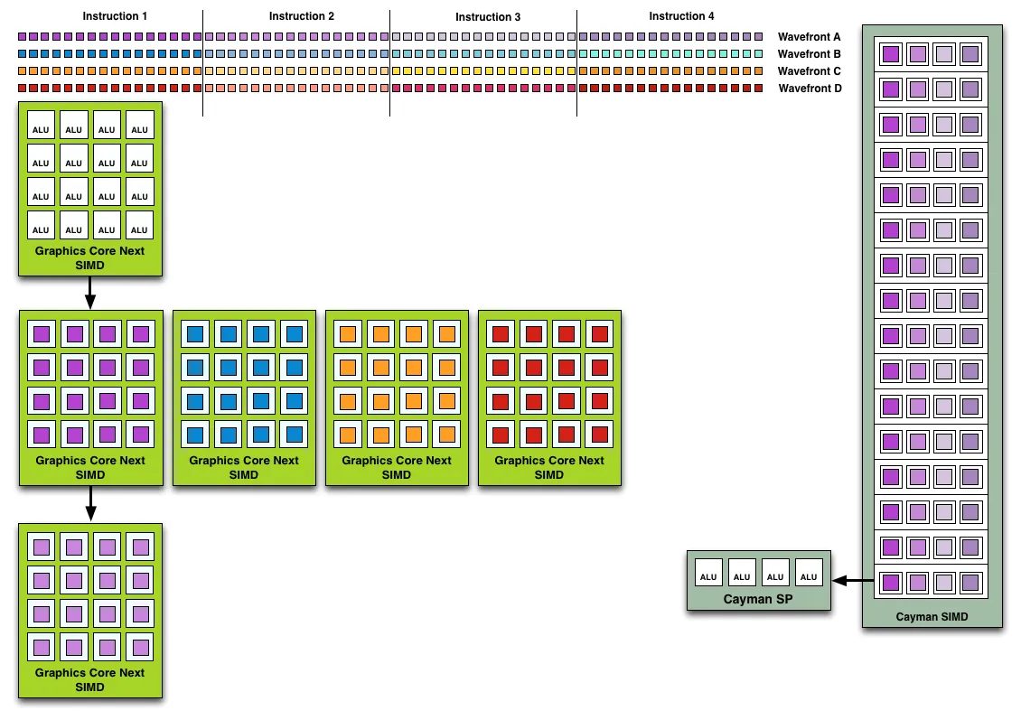
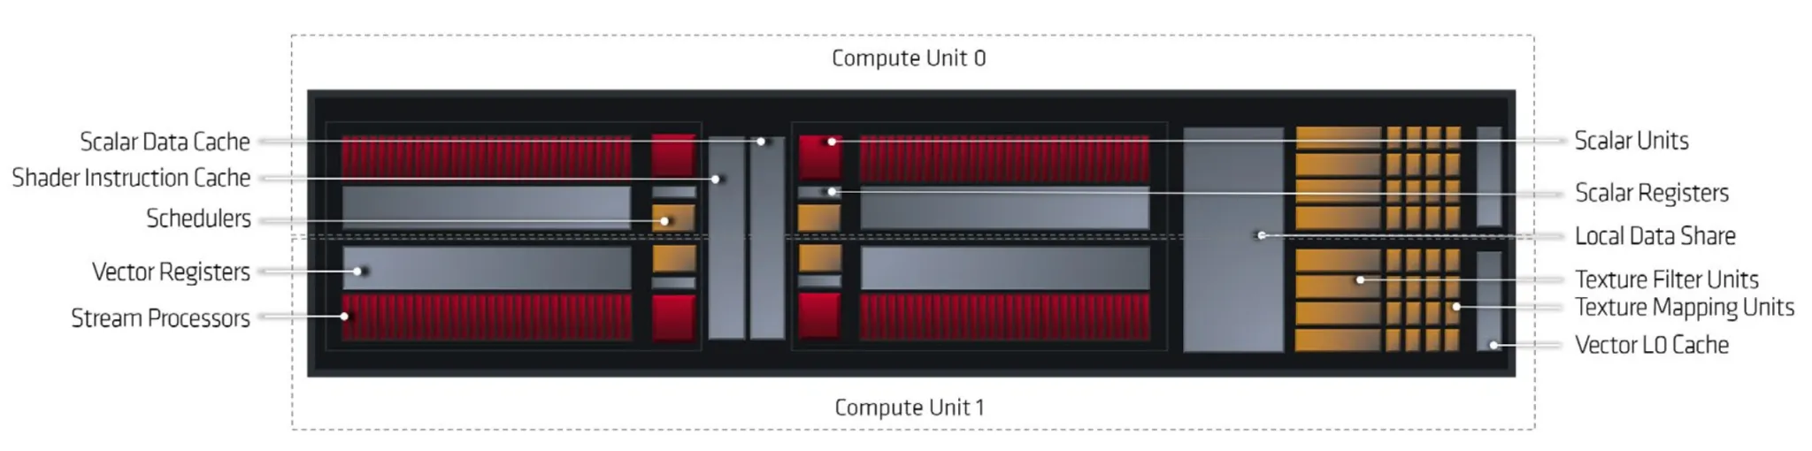
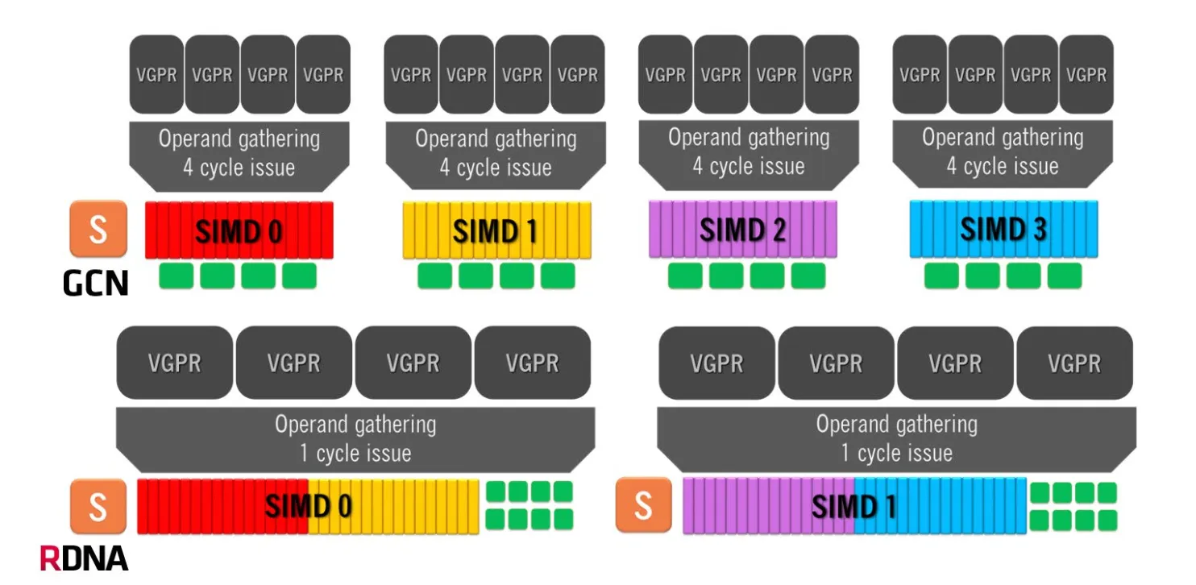
AMD GPU
Product timeline
GCN GPU
RDNA2 GPU
two CUs working in tandem with shared local data.
The RDNA SIMDs consist of 32 shaders or ALUs, twice that of GCN. There are two SIMDs per CU and four in a Dual Compute Unit.
64 wavefronts or work-items (and ALUs/cores) per Compute Unit.
divided into four SIMDs (Single Instruction On Multiple Data Types), each packing 16 ALUs (SP)
This arrangement allows the execution of one whole wavefront in one clock cycle
Notes:
at a time each Compute Unit would also work on four 64-item waves, the reason why this isn’t very effective is that most games use shorter work queues due to which only one or two out of the four wavefronts were saturated per execution cycle, wait for four cycles for the next one despite having room for additional wavefronts.
By completing a wavefront 4x faster, the registers and cache are freed up much faster

Slide 11
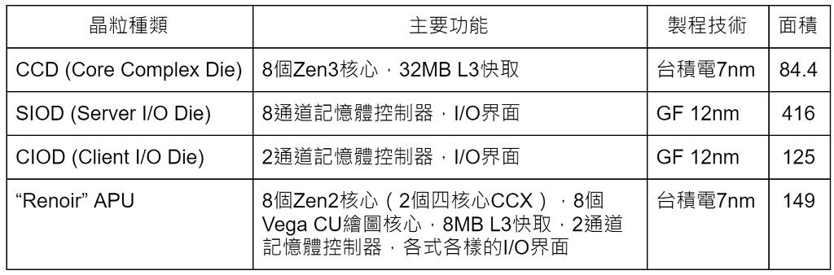
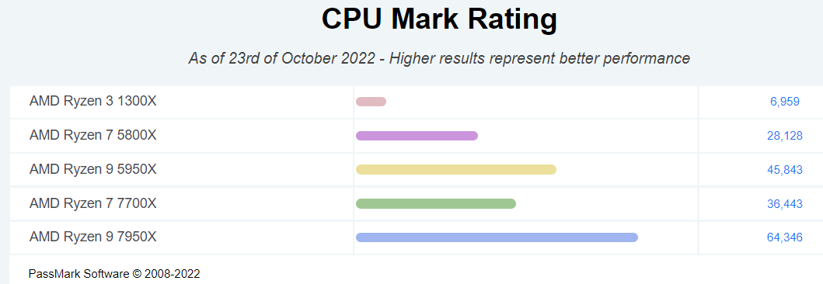
series |  | 1000 series | 5000 series | 5000 series | 7000 series | 7000 series | 7000 series
Model |  | Ryzen 3 1300X | Ryzen 7 5800X | Ryzen 9 5950X | Ryzen 5 7600X | Ryzen 7 7700X | Ryzen 9 7950X
Release date and price |  | 2017/07/27 US$129 | 2020/11/05 US$449 | 2020/11/05 US$799 | 2022/09/27 US$299 | 2022/09/27 US$399 | 2022/09/27 US$699
Fab |  | GloFo 14LP | TSMC N7 | TSMC N7 | TSMC N5 | TSMC N5 | TSMC N5
Chiplets |  | 1×CCD | 1×CCD 1×I/OD | 2×CCD 1×I/OD | 1×CCD 1×I/OD | 1×CCD 1×I/OD | 2×CCD 1×I/OD
CPU | Cores(threads) | 4 (4) | 8 (16) | 16 (32) | 6 (12) | 8 (16) | 16 (32)
 | Core config | 2×2 | 1×8 | 2x8 | 1×6 | 1×8 | 2×8
 | Clock rate (GHz) Base/ Boost | 3.5/ 3.7 | 3.8/ 4.7 | 3.4/4.9 | 4.7/ 5.3 | 4.5/ 5.4 | 4.5/ 5.7
 | Cache L1/L2/L3 | 64 KB/2 MB/8 MB | 512 KB/4 MB/32 MB | 1MB/8MB/64MB | 384 KB/6 MB/32 MB | 512 KB/8 MB/32 MB | 1 MB/16 MB/64 MB
GPU | Architecture | - | - | - | RDNA 2 | RDNA 2 | RDNA 2
 | CUs | - | - | - | 2 | 2 | 2
 | Clock rate (GHz) Base/ Boost | - | - | - | 0.4/2.2 | 0.4/2.2 | 0.4/2.2
 | Processing power(GFLOPS) | - | - | - | 563 | 563 | 563
Socket |  | AM4 | AM4 | AM4 | AM5 | AM5 | AM5
PCIe lanes |  | 24 (20+4) PCIe 3.0 | 24 (20+4) PCIe 4.0 | 24(20+4) PCle 4.0 | 28 (24+4) PCIe 5.0 | 28 (24+4) PCIe 5.0 | 28 (24+4) PCIe 5.0
Memory support |  | DDR4-2667 dual-channel | DDR4-3200 dual-channel | DDR4-3200 dual-channel | DDR5-5200 dual-channel | DDR5-5200 dual-channel | DDR5-5200 dual-channel
TDP |  | 65 W | 105 W | 105 W | 105 W | 105 W | 170 W
Product timeline

Slide 12
System description

Slide 13
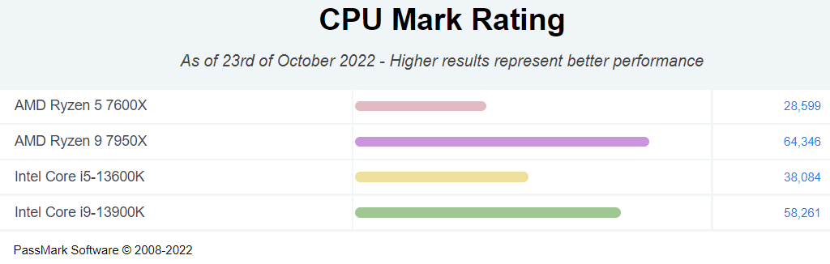


System description
Model |  | Core i5 13600K | Core i7 13700K | Core i9 13900K | Ryzen 5 7600X | Ryzen 7 7700X | Ryzen 9 7950X
Release date and price |  | 2022/09/27 US$319 | 2022/09/27 US$409 | 2022/09/27 US$589 | 2022/09/27 US$299 | 2022/09/27 US$399 | 2022/09/27 US$699
Fab |  | Intel 7 | Intel 7 | Intel 7 | TSMC N5 | TSMC N5 | TSMC N5
Chiplets |  | - | - | - | 1×CCD 1×I/OD | 1×CCD 1×I/OD | 2×CCD 1×I/OD
CPU | Cores(threads) | 14 (20) | 16 (24) | 24 (32) | 6 (12) | 8 (16) | 16 (32)
 | Core config | - | - | - | 1×6 | 1×8 | 2×8
 | Clock rate (GHz) Base/ Boost | 3.5/ 5.1 | 3.4/ 5.4 | 3.0/ 5.8 | 4.7/ 5.3 | 4.5/ 5.4 | 4.5/ 5.7
 | Cache L1/L2/L3 | 24 MB Intel® Smart Cache | 30 MB Intel® Smart Cache | 36 MB Intel® Smart Cache | 384 KB/6 MB/32 MB | 512 KB/8 MB/32 MB | 1 MB/16 MB/64 MB
GPU | Architecture | Gen12 UHD 770 | Gen12 UHD 770 | Gen12 UHD 770 | RDNA 2 | RDNA 2 | RDNA 2
 | Execution Units /Compute Units | 32 | 32 | 32 | 2 | 2 | 2
 | Clock rate (GHz) Base/ Boost | 0.3/1.55 | 0.3/1.6 | 0.3/1.65 | 0.4/2.2 | 0.4/2.2 | 0.4/2.2
 | Processing power(GFLOPS) | - | - | - | 563 | 563 | 563
Socket |  | LGA 1700 | LGA 1700 | LGA 1700 | AM5 | AM5 | AM5
PCIe lanes |  | 20 PCIe 4.0 | 20 PCIe 4.0 | 20 PCIe 4.0 | 28 (24+4) PCIe 5.0 | 28 (24+4) PCIe 5.0 | 28 (24+4) PCIe 5.0
Memory support |  | DDR4-3200 /DDR5-5600 | DDR4-3200 /DDR5-5600 | DDR4-3200 /DDR5-5600 | DDR5-5200 dual-channel | DDR5-5200 dual-channel | DDR5-5200 dual-channel
TDP |  | 125 W/181 W (base/turbo) | 125 W/253 W (base/turbo) | 125 W/253 W (base/turbo) | 105 W | 105 W | 170 W

Slide 14
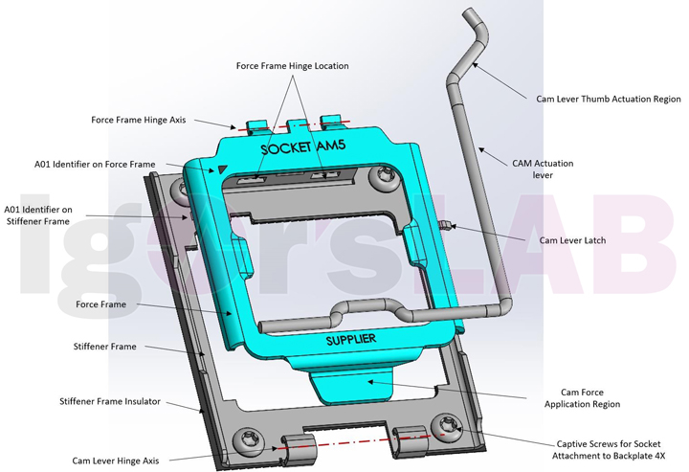
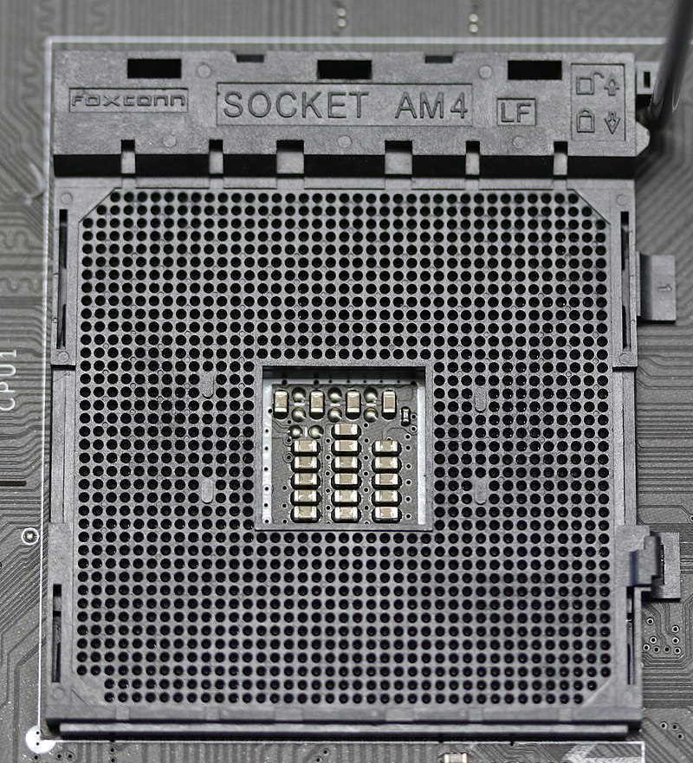
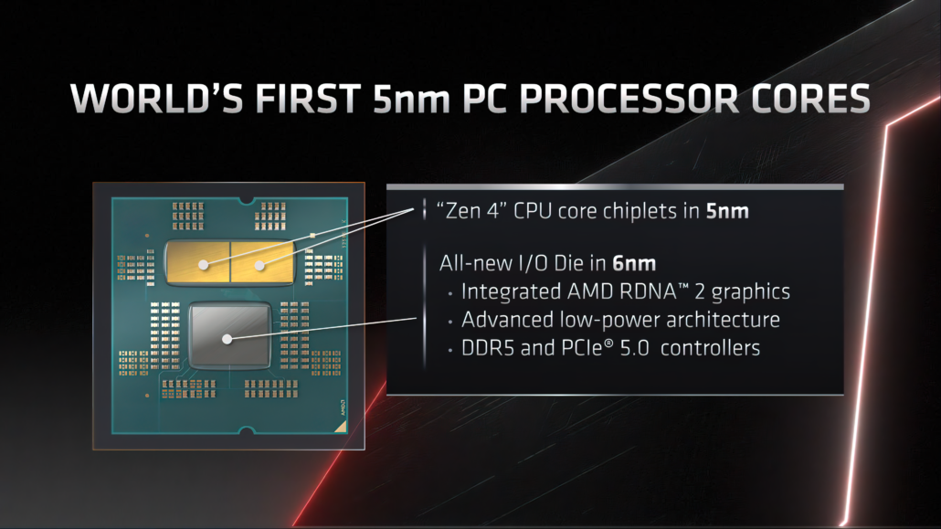
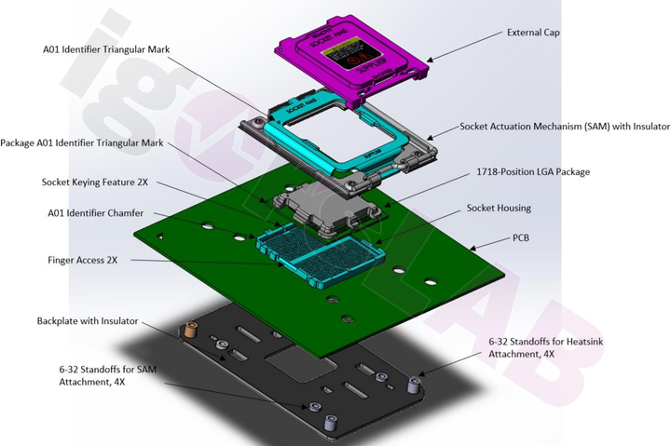
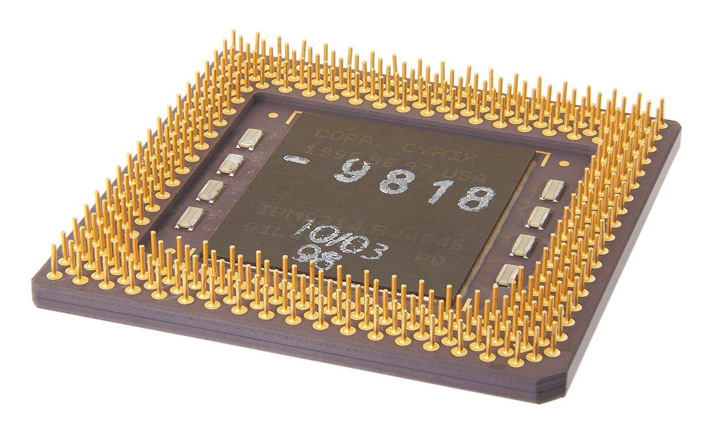
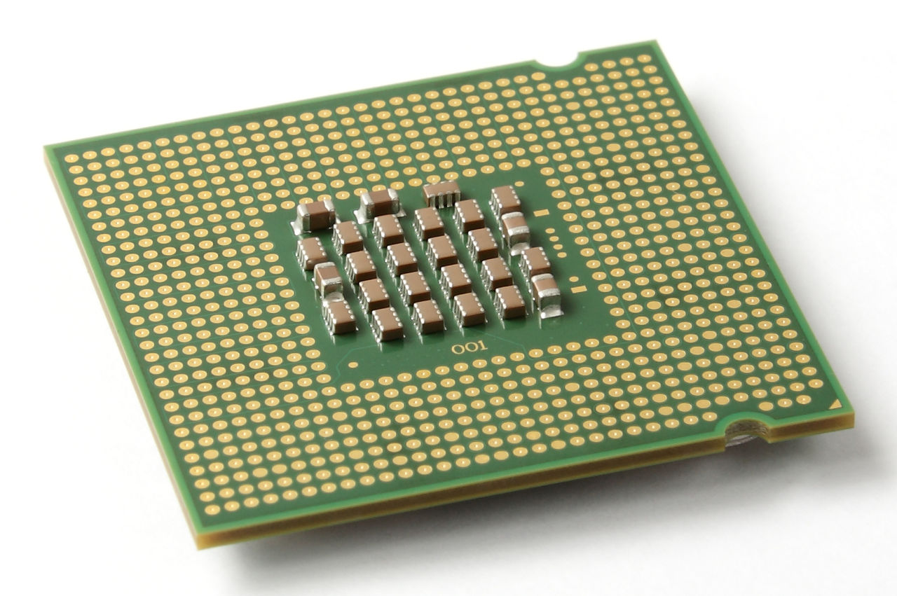
AM5 V.S. AM4
System description
AMD expanded its maximum capacity from 142 watts to 230 watts
allowing the newest Ryzen 7000 CPUs to have a maximum TDP of 170 watts
49% more powerful while utilizing the same amount of power, and it is 62% more efficient at the same performance
7000series have Integrated graphics RDNA 2
from the PGA(pin grid array) to the LGA(land grid array), 1,718 pins, AM5 is a significant upgrade over AM4’s 1331
Notes:
no pins on the chip, in place of the pins are pads of bare gold-plated copper that touch protruding pins on the microprocessor's connector on the motherboard
reduces the likelihood of the chip being damaged either before or during installation as there are no pins that can be accidentally bent

Slide 15
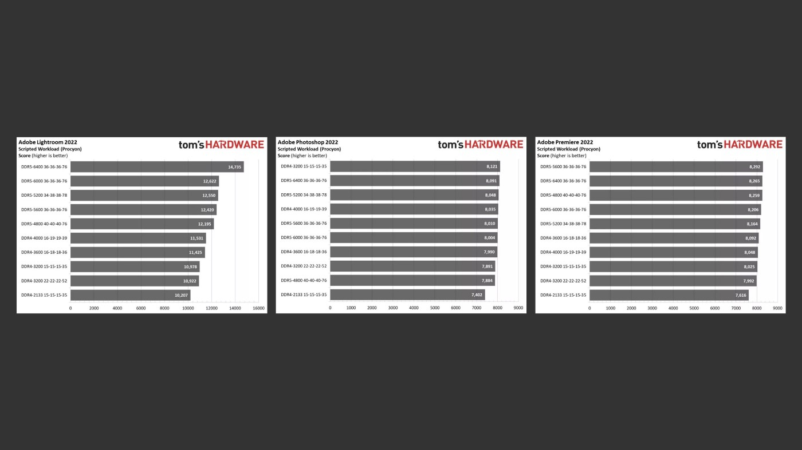
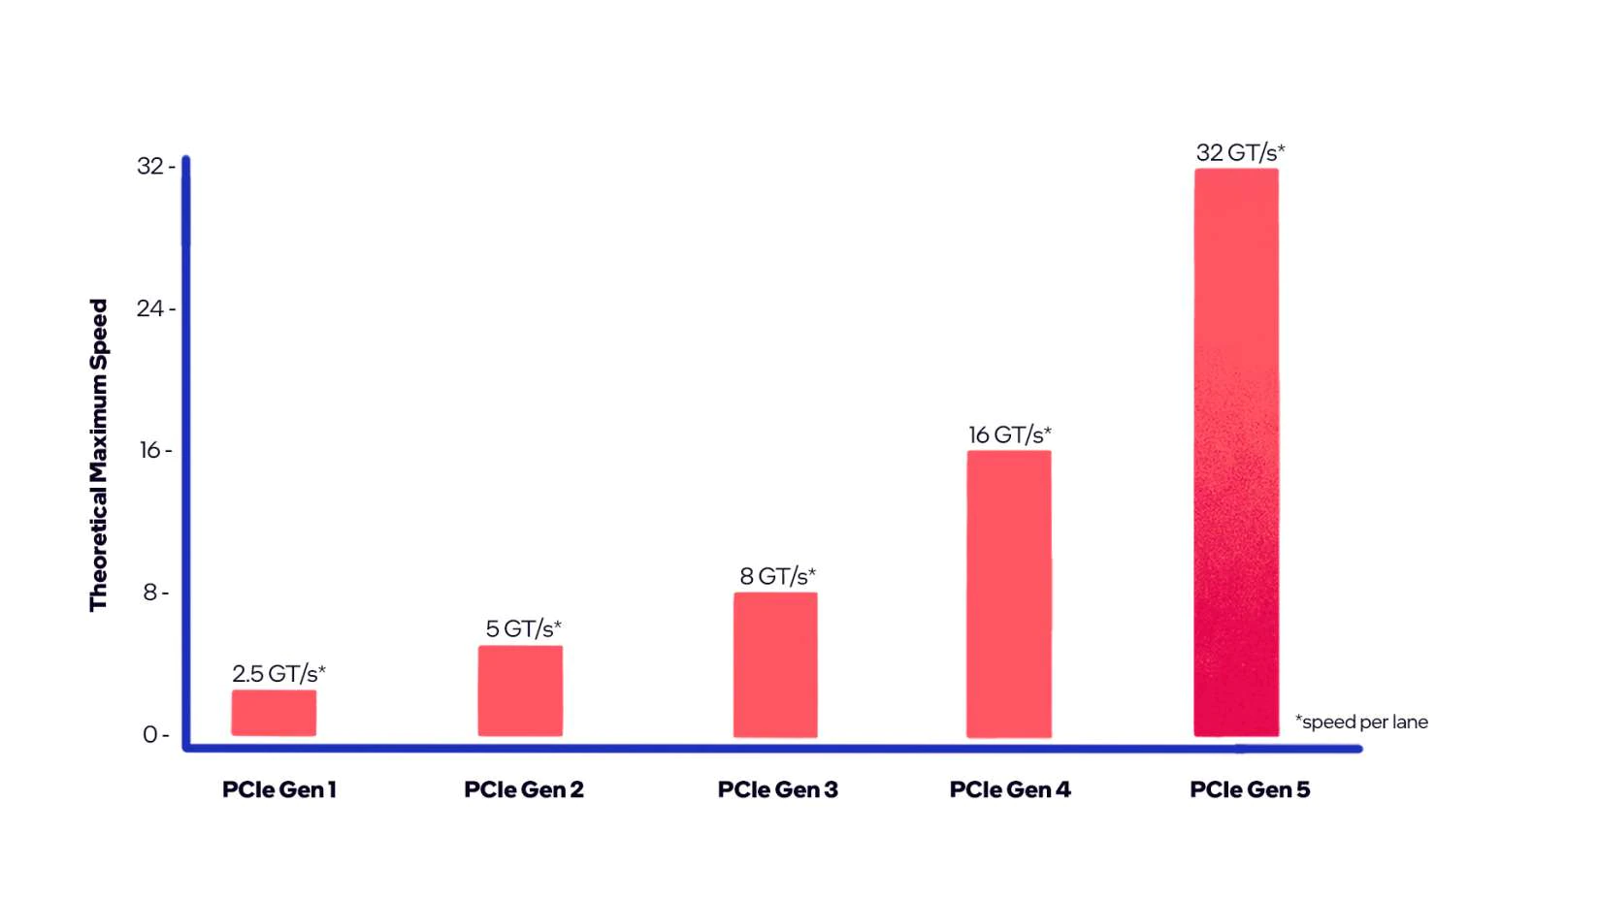
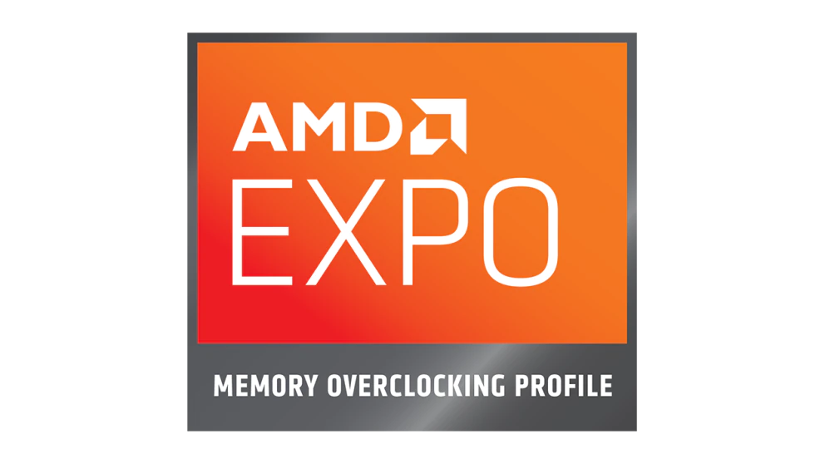
AM5 V.S. AM4
System description
Up to DDR5 memory
Up to PCle 5.0
AMD EXPO technology is available
gaming experience that is up to 11% quicker. Reduce lag time to 63 nanoseconds or less
AM5 vs LGA 1700(intel)
AM5 has PCI-e Gen 5 storage
LGA 1700 has flexible DDR4 or DDR5 platform set
Notes:
PCIe 3.0 8 Gigatransfer PCIe 4.0 16 GT/s PCIe 5.0 32 GT/s
Red is AM5 and blue is AM4

Slide 16
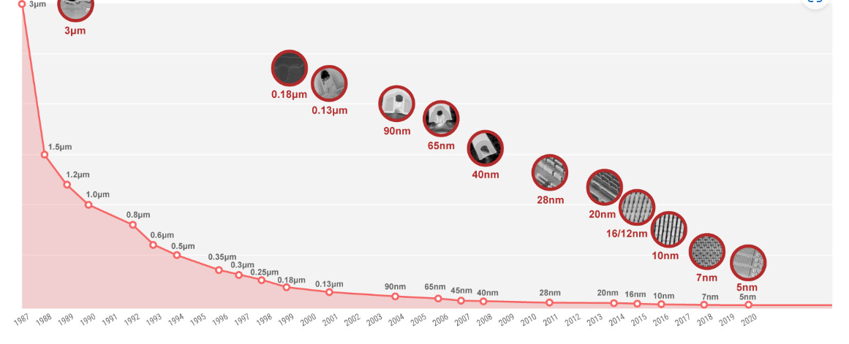
TSMC N5
System description
Process | N5 | N7
Transistor density (MTr/mm2) | 138.2 | 91.2–96.5
SRAM bit-cell size (μm2) | 0.021 | 0.027
Transistor gate pitch (nm) | 51 | 54
Interconnect pitch (nm) | 28 | 40
Process | N5 | Intel 7
Transistor density (MTr/mm2) | 138.2 | 100.76–106.1
SRAM bit-cell size (μm2) | 0.021 | 0.0312
Transistor gate pitch (nm) | 51 | 54
Interconnect pitch (nm) | 28 | 30
15% speed improvement or 30% lower power consumption

Slide 17
Industry analysis

Slide 18
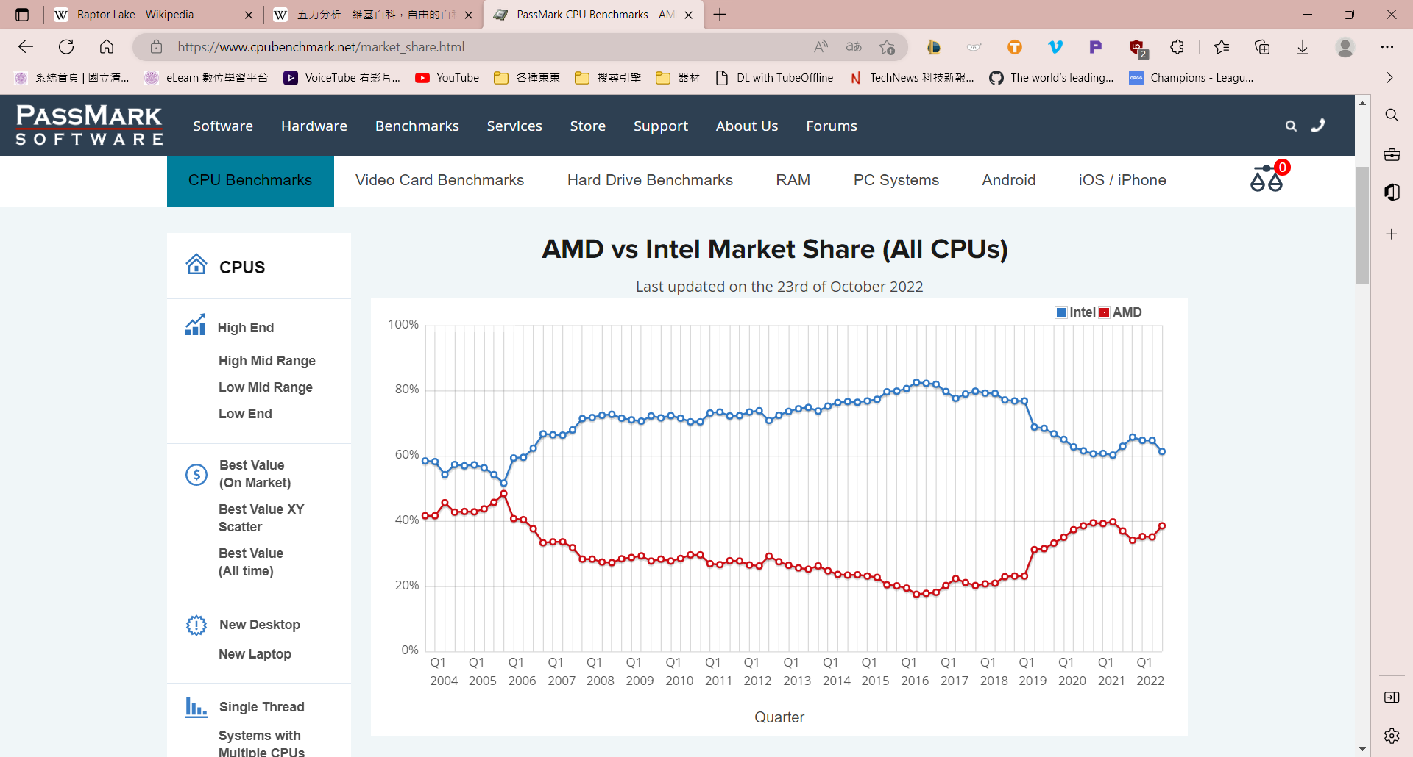
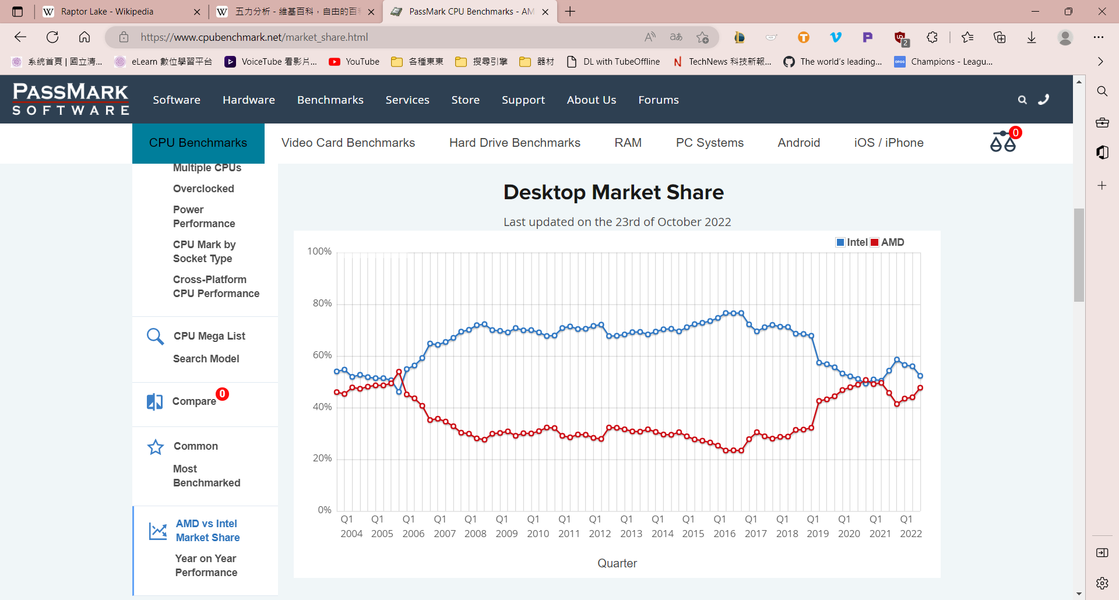
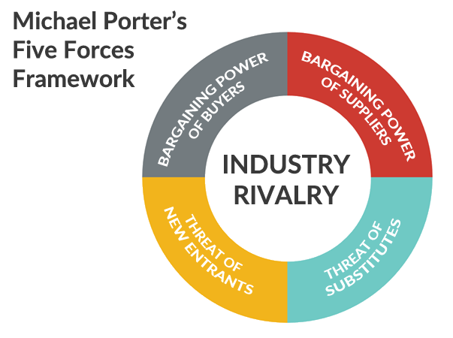
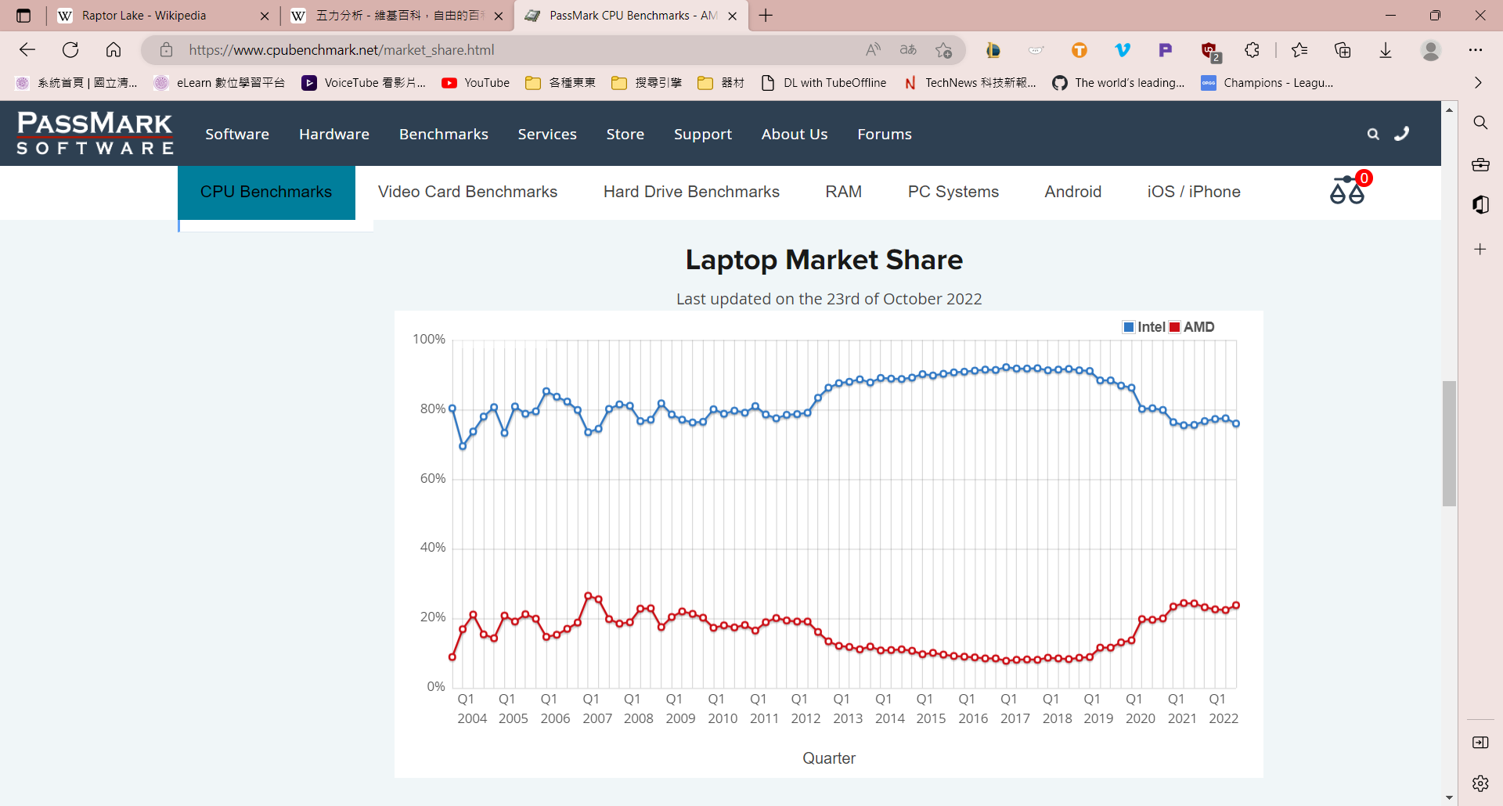
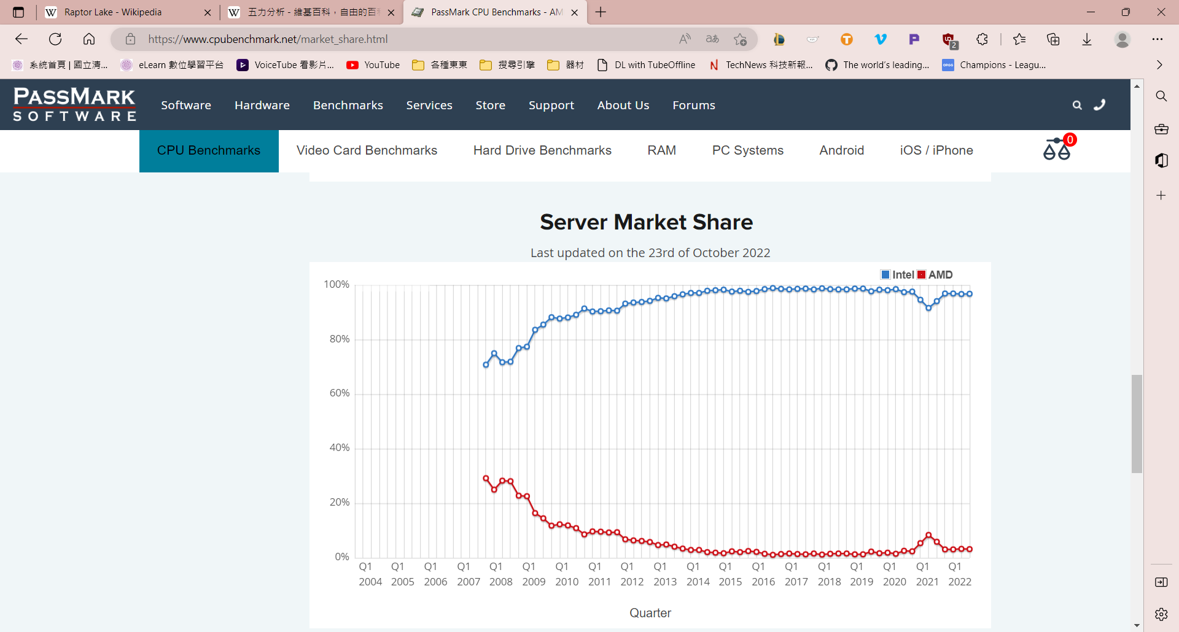
Porter’s 5 Forces analysis
Industry analysis
Even though AMD may have similar desktop market share, intel tend to keep lead in the CPU market

Slide 19
Porter’s 5 Forces analysis
Industry analysis
Threats of New Entrants
Bargaining Power of Suppliers
By innovating new products and services
By building efficient supply chain with multiple suppliers
By building economies of scale so that it can lower the fixed cost per unit
Developing dedicated suppliers whose business depends upon the firm
Building capacities and spending money on research and development
By experimenting with product designs using different materials so that
if the prices go up of one raw material then company can shift to another
Bargaining Power of Buyers
Threats of Substitute Products or Services
By building a large base of customers
By being service oriented rather than just product oriented
By rapidly innovating new products
By understanding the core need of the customer rather than what the customer is buying
New products will also reduce the defection of existing customers
of Advanced Micro Devices, Inc. to its competitors
By increasing the switching cost for the customers
Rivalry among the Existing Competitors
By building a sustainable differentiation
By building scale so that it can compete better
Collaborating with competitors to increase the market size rather than just competing for small market.

Slide 20
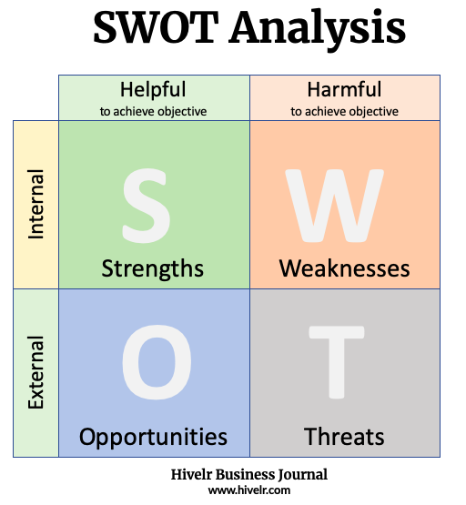
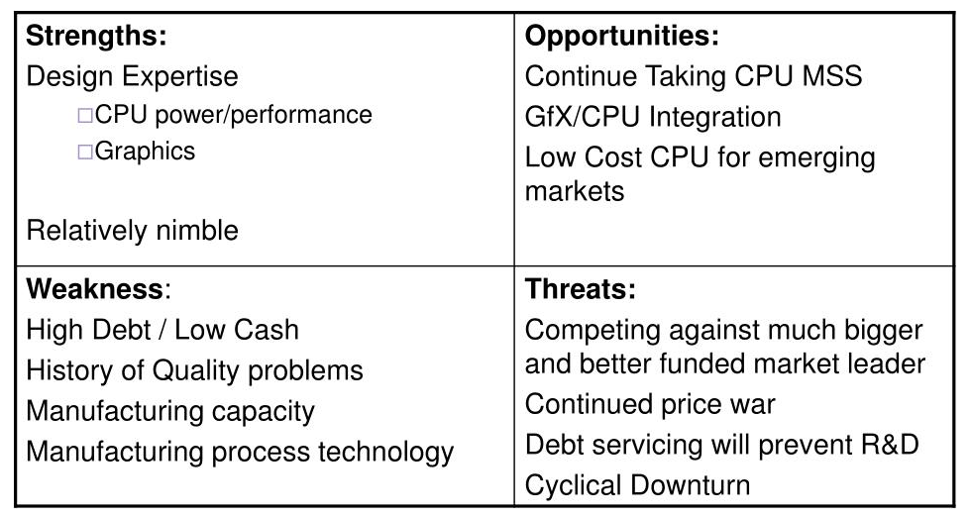
SWOT analysis
Industry analysis
Lower Performance of the Computing Segment
The less seen in Mobile Market
Lower Market share
Quality Problems
High-Performance Computer
AMD Quality Policy
Key areas
Technology and Innovation
Global Operations
Strategic Sourcing
Outstanding research and Research and Development
With fewer competitors
Technologies
Achieving History
Guinness World Record Achievement
Permeate to Mobile
New product as well as Services
Virtualization Space
Lost cost CPU
New Trends in Consumer Behavior
Rivals
Environmental Regulations
Rise in Raw Materials
Notes:
1providing high-performance computing and graphics products
2helps them to ensure that their products are up to top quality
3Key Areas of HTML0 AMD is a well-known branding recognition within the Microprocessor and PC market
8There are fewer competitors AMD principal area of Graphical Processing Unit and Microprocessor has just one competitor on the market
1low performance in the computing segment due the advent of mobile devices and tablets
2AMD is ignoring the mobile market, where there’s plenty of business transactions that are conducted via mobile today
3AMD has a high level of competition in HTML0, the market share of HTML0 is less
4Quality Issues AMD has had issues with regards to quality over the many years
1AMD should broaden its operations to tablets and mobile platforms
2should increase its product range and services
1Competitors AMD has two competitors that are major players on the market: AMD and Nvidia as well as Intel.
2Different environmental regulations pose extremely harmful to existing product categories , and could impact the production

Slide 21
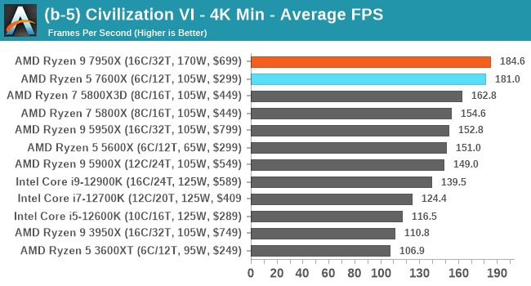
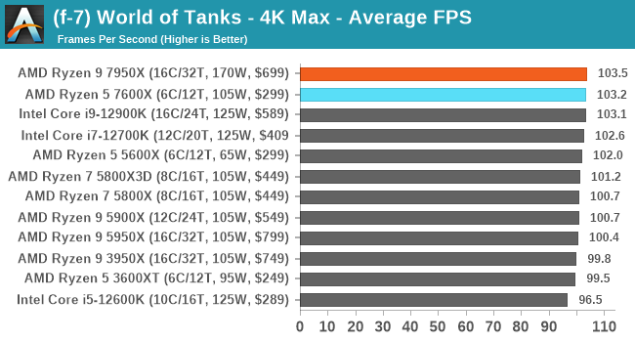
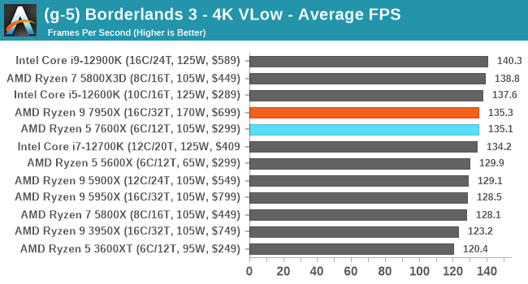
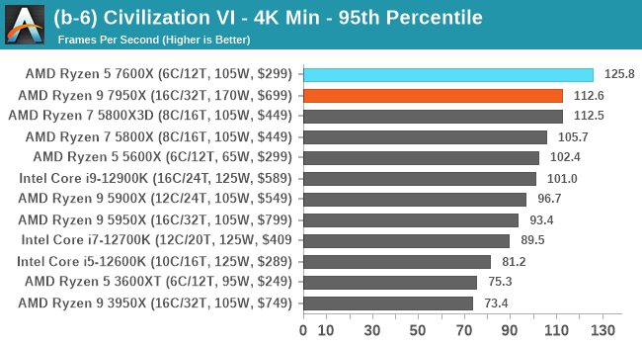
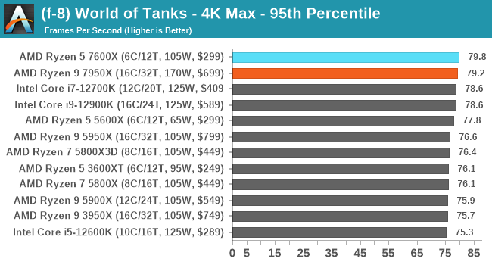
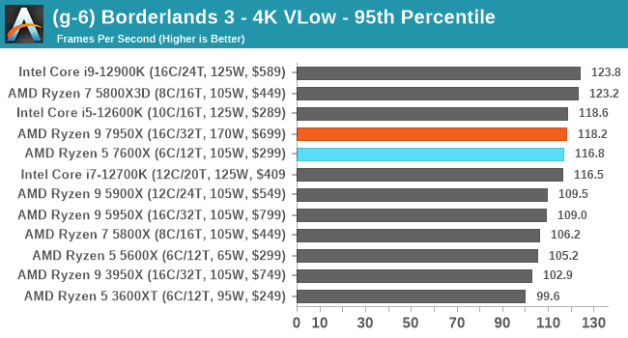
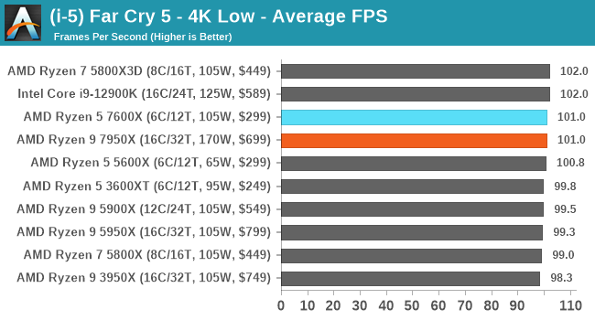
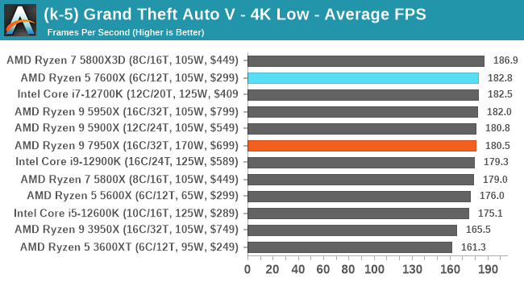
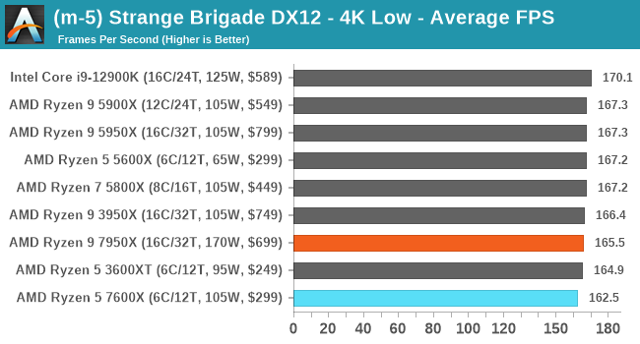
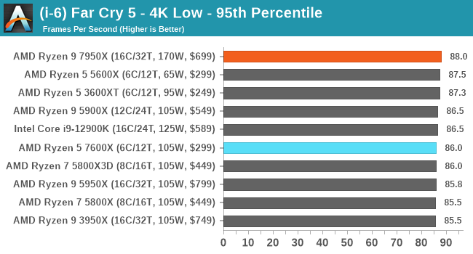
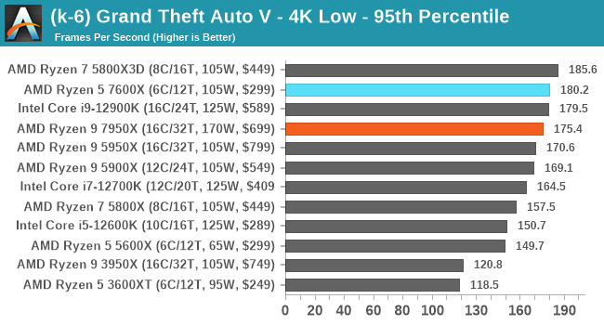
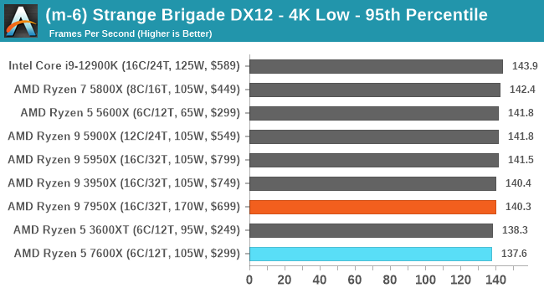
Applications
All gaming tests were with an RTX 2080 Ti
Notes:
The 95th percentile is a number that is greater than 95% of the numbers in a given set, it gives a very accurate picture of the maximum traffic generated on an interface for interpreting performance data

Slide 22
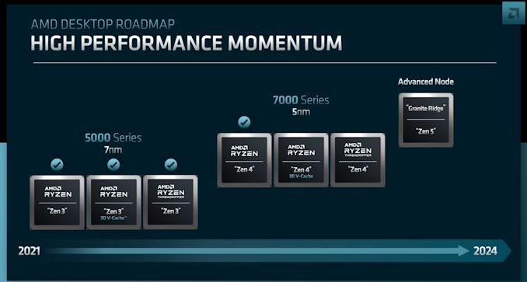
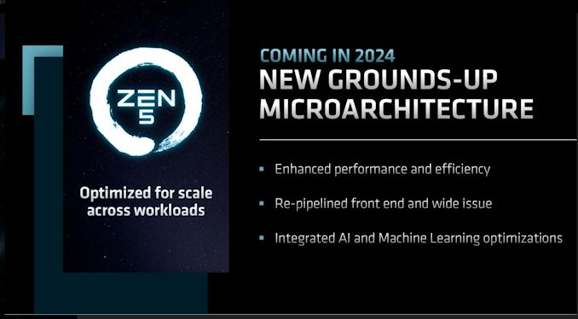
future
Zen 5”-based “Granite Ridge” processors
AMD's 3D V-Cache packaging technology will also come to client desktop Zen 4

Slide 23
reference
Total MPU Sales Surprise With Strong Gains in 2020, More Upside in 2021 (design-reuse.com)
Raptor Lake – Wikipedia
AMD Ryzen 5 7600X vs AMD Ryzen 9 7950X vs Intel Core i5-13600K vs Intel Core i9-13900K [cpubenchmark.net] by PassMark Software
AMD Ryzen 3 1300X vs AMD Ryzen 7 5800X vs AMD Ryzen 9 5950X vs AMD Ryzen 7 7700X vs AMD Ryzen 9 7950X [cpubenchmark.net] by PassMark Software
AM5 vs. AM4: Worth The Upgrade? - Tech4Gamers
https://en.wikipedia.org/wiki/Ryzen
https://en.wikipedia.org/wiki/5_nm_process#cite_note-41
https://www.anandtech.com/show/17585/amd-zen-4-ryzen-9-7950x-and-ryzen-5-7600x-review-retaking-the-high-end/6

Slide 24
Thank you

